Slide 1
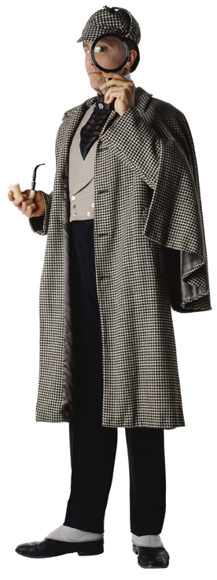
Business Research Methods
CHAPTER NINETEEN

Slide 2

OVERVIEW
Primary and secondary research differences
Direct and indirect library research
Online searches
Evaluating websites
Methods for gathering primary data
Analyzing and interpreting data for your reader

Slide 3
Two Basic Forms of Research
Secondary
  Secondary research is research with data compiled and interpreted by someone else. It is usually library and online research.
Primary
  Primary research uses data compiled and interpreted firsthand by the writer.

Slide 4
Finding Publication Collections
Types of Libraries
General Libraries
Special Libraries
  Private business libraries
  Association libraries
  Public and private research organization libraries

Slide 5
Finding Publication Collections
Directories
The American Library Directory -- a geographic listing of libraries in the US and Canada
The Research Centers Directory -- a listing of research activities, publications, and services. Supplemented between editions by New Research Centers
The Directory of Special Libraries and Information Centers a comprehensive three-volume guide to special library collections. Volumes cover contents, services, and addresses of 23,000 special libraries and centers.

Slide 6
Sources for Direct Access
Encyclopedias
Biographical Directories
Almanacs
Trade Directories
Government Publications
Dictionaries
Statistical Sources
Business Information Services
International Sources

Slide 7
Sources for Indirect Access
The Online Catalog
Online Databases
The Internet
  Search Engines—single, meta, and specialized
  Personal Agents

Slide 8
Boolean Search Problem Example
To find sources on advertising other than television by attorneys or lawyers.
Step
Operator
Sample
Result
1
OR
Lawyer
Attorney
Set 1
2
NOT
Advertising
Television
Set 2
3
AND
Set 1
Set 2
Set 3=Solution

Slide 9
Expanding and Limiting Searches
If you have too few citations
  Add a synonym for your major terms
  Check for incorrect spelling
  Truncate major terms to pick up variations
If you have too many citations
  Combine using AND with another term or concept
  Check descriptors of good hits and drop terms not used in them
  Specify dates or other limitations
  Consider narrowing with NOT

Slide 10
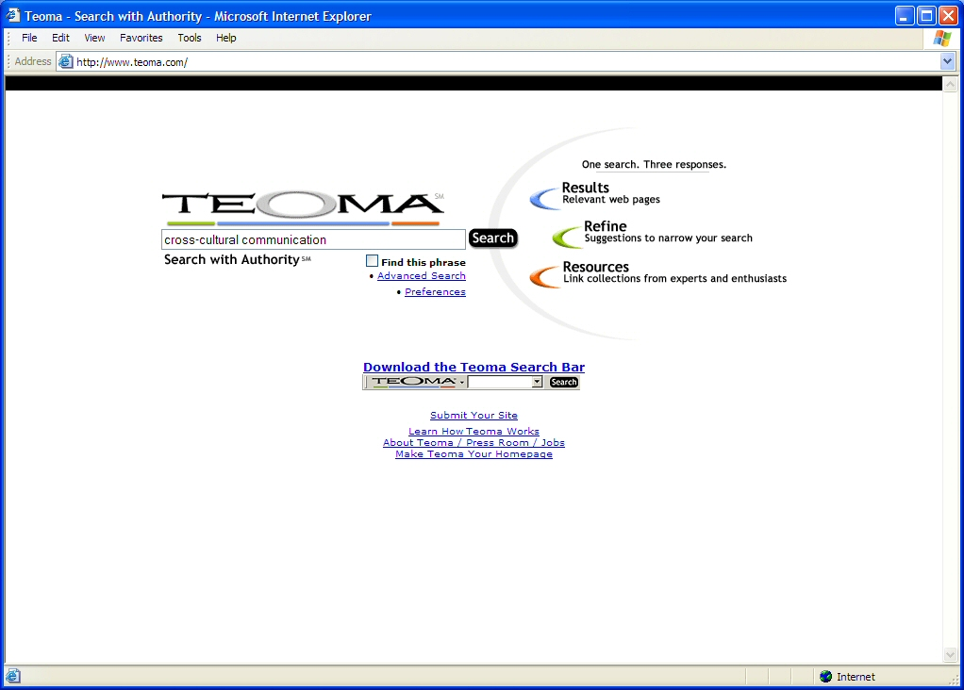

Slide 11
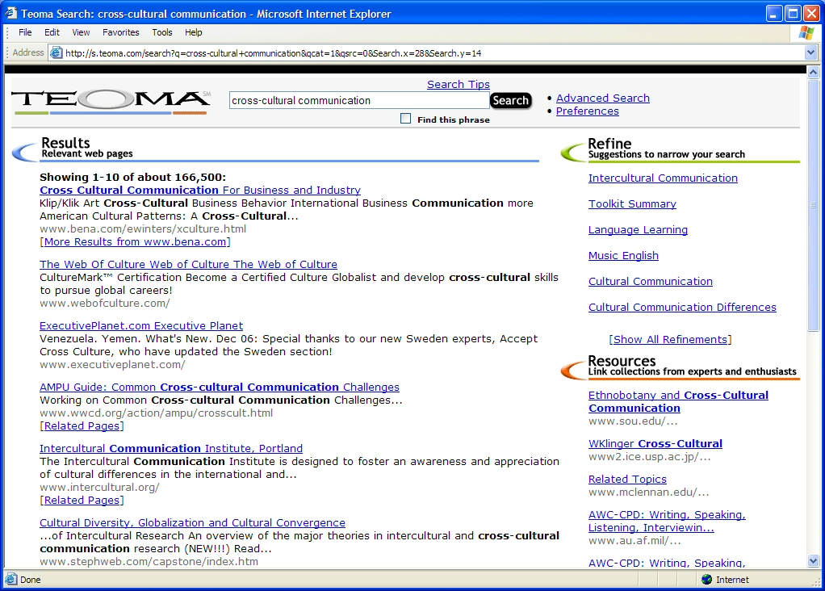

Slide 12
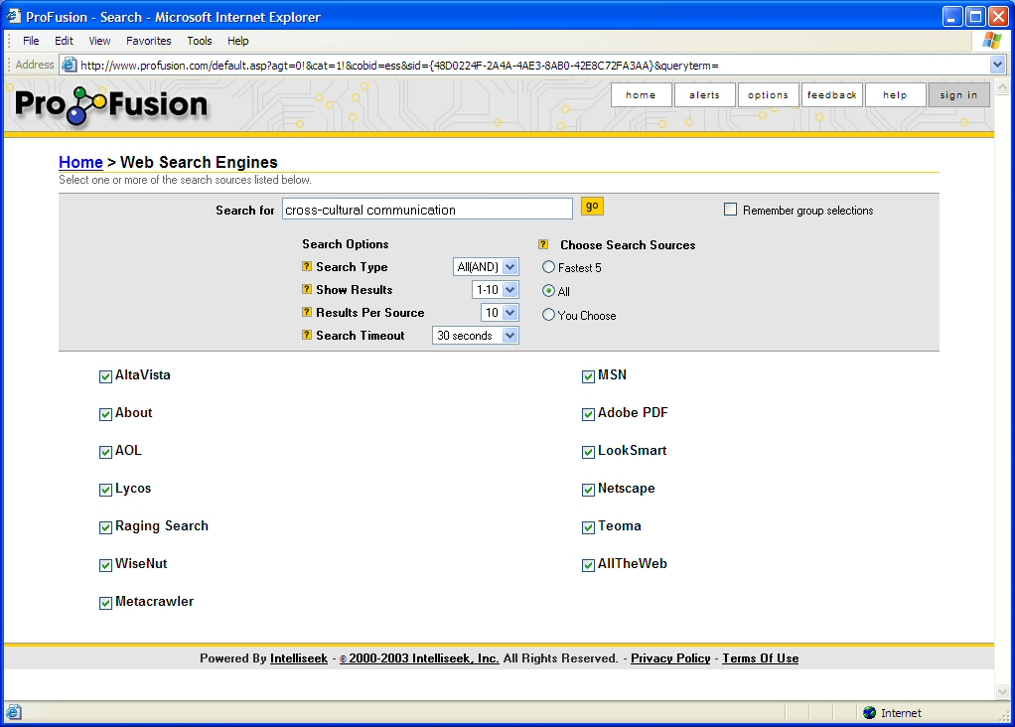

Slide 13
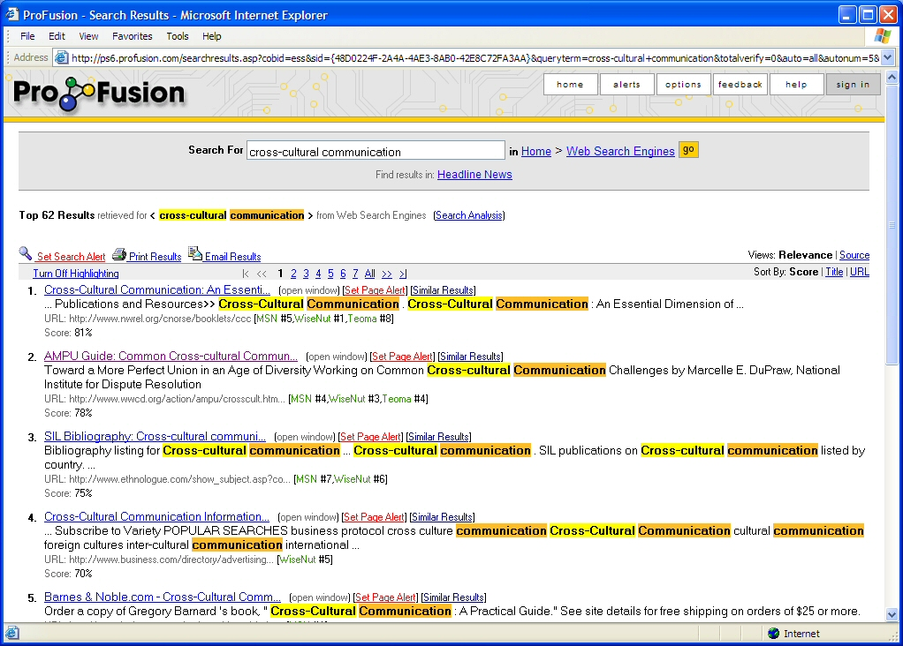

Slide 14
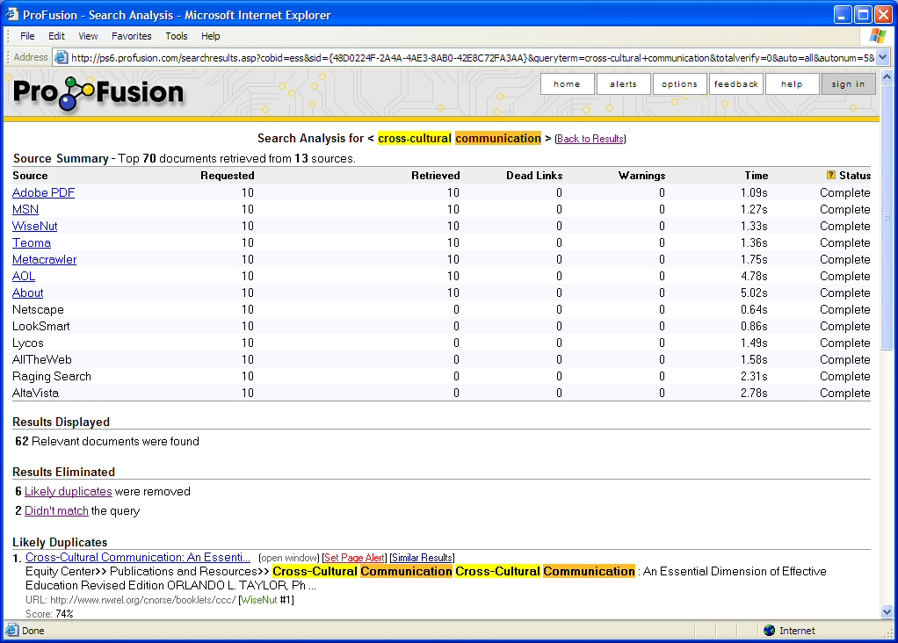

Slide 15
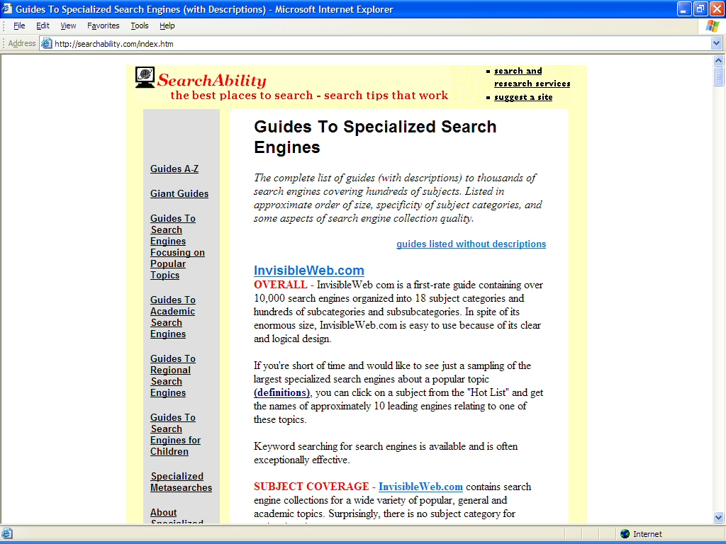

Slide 16
Evaluating Websites
No widely adopted standards are currently followed.
Search engine biases are not widely understood and change with policy and algorithm updates.
One solution is to link only through trustworthy collection sites.
A better solution is to hone evaluation skills by habitually looking at each site’s
  purpose,
  provider’s qualifications,
  content validity, and
  structure.

Slide 17
Primary Sources
Company Records
Experiment
Observation
Survey Research

Slide 18
Before-After Design
Experiments
Select experimental group
Measure variable
Difference in measurements could be caused by the experimental factor
Inject experimental factor
Measure variable

Slide 19
Controlled Before-After Design
Experiments
Select experimental group
Select control group
Measure variable
Measure variable
Attribute difference in measurement to experimental factor plus other influences.
Attribute difference in measurement to other influences only.
Inject experimental factor
Measure variable
Measure variable

Slide 20
Good Plan Brings Good Results
Survey
Use a good sample -- one that controls for sampling error and bias
Use good survey design -- one that is valid and reliable

Slide 21
Types of Samples
Probability
Samples based on chance selection. Every element in the population has a known nonzero probability of selection.
Nonprobability
Samples based on an unknown probability of any one of the population being chosen.
Random
Stratified Random
Systematic
Area or Cluster
Convenience
Quota
Referral

Slide 22
Survey Design Phases
Constructing the Questionnaire
Selecting the Manner of Questioning
Developing a Working Plan
Conducting a Pilot Study
Evaluating and Reporting Data

Slide 23
Basic Rules for Constructing Questionnaires
Avoid leading questions.
Make the questions easy to understand.
Avoid questions that touch on personal prejudices and pride.
Seek facts as much as possible.
Ask only for information that can be remembered.
Plan the physical layout with foresight.
Use scaling when appropriate.

Slide 24
Manners of Questioning
Personal
Telephone
Mail/Email/Web

Slide 25
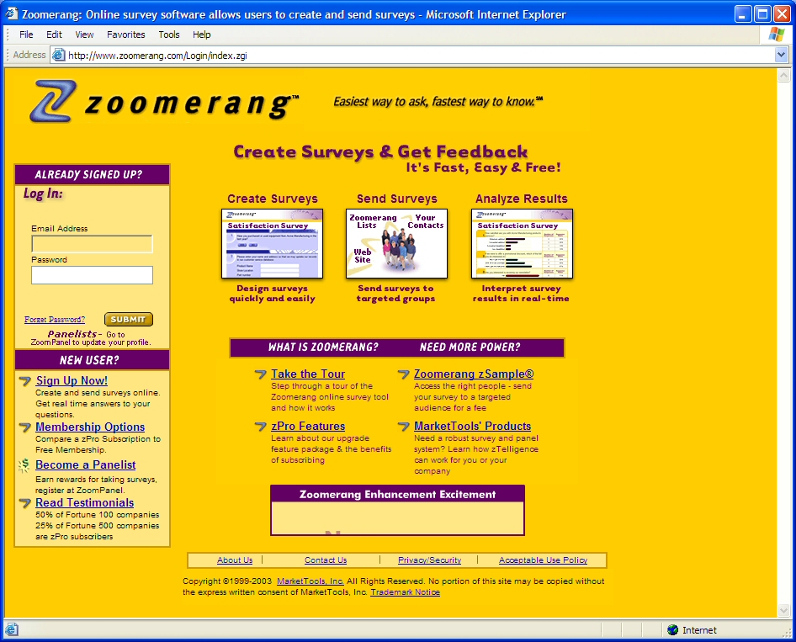

Slide 26
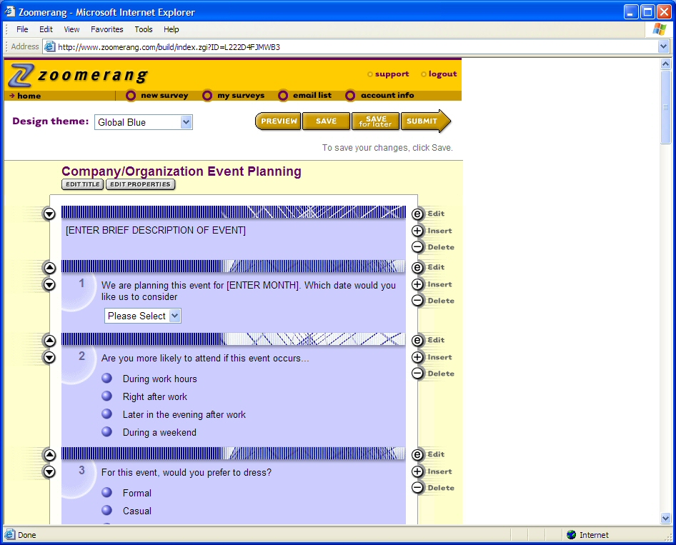

Slide 27
Planning and Testing
Develop a working plan that anticipates possible problems.
Conduct a pilot test for your questionnaire and working plan.
Modify the plan and questionnaire for use in the full-scale survey

Slide 28
Evaluating/Reporting Results
Have the methods of collecting facts been presented clearly?
Are the sources reliable?
Are the conclusions drawn supported by the data presented and without bias?
Are there any gaps or holes in the research?
Are the results presented accurately and clearly for the reader?
Is the report complete and honest?

Slide 29
“Nothing in the world can take the place of persistence. Talent will not; nothing is more common than unsuccessful men with talent. Genius will not; unrewarded genius is almost a proverb. Education will not; the world is full of educated derelicts. Persistence and determination alone are omnipotent.”
--Calvin Coolidge

